Slide 1
OPENING CONFERENCE (ONLINE)
(EuropeAid/140341/IH/SER/TR)
22 JUNE 2021

Slide 2
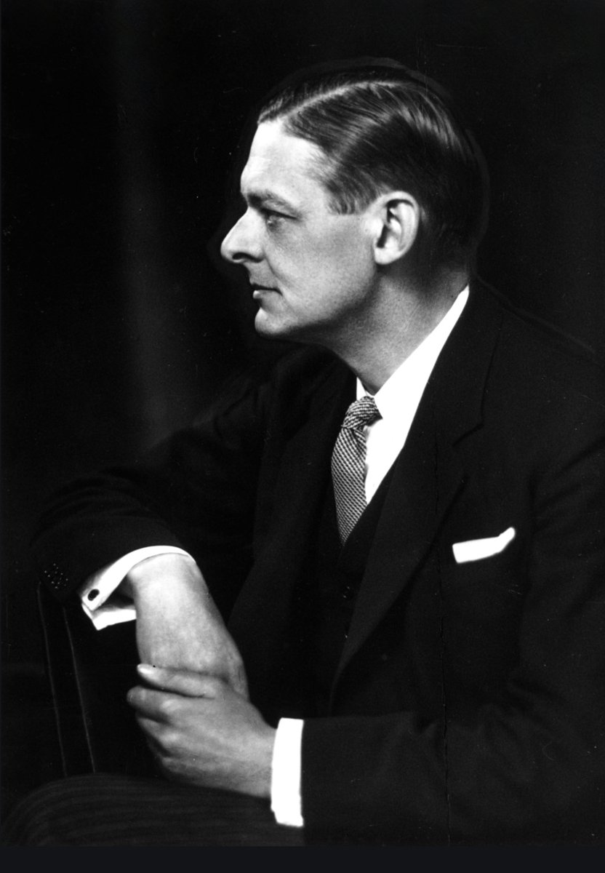
TIME
“Time present
and time past
Are both perhaps
present in time future
And time future
contained in time past.”
TS Eliot: The Four Quartets, 1943

Slide 3
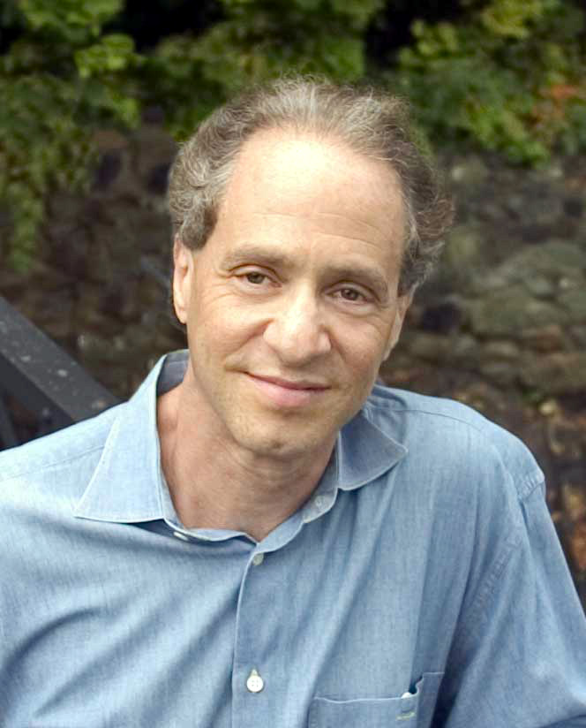
THE EXPONENTIAL GROWTH OF KNOWLEDGE
“Knowledge increases with time: the first major developments took centuries while now, knowledge is doubling every decade. Changes and progress which took 200 centuries to materialise will now take place every 25 years.”
‘The Law of Accelerating Returns’ Ray Kurzweil (born 1948)

Slide 4
IMPACT ON JOBS by 2030
Global Trends: 50% of jobs can be automated
Turkey Jobs: 7.6m lost
8.9m created
= 1.3m net gain
PROVIDED…..relevant skills are developed

Slide 5
THE FUTURE IS…. V.U.C.A.
Volatile
Uncertain
Complex
Ambiguous

Slide 6

OUR PROJECT
PROMOTING DECENT FUTURE OF WORK APPROACH WITH A FOCUS ON GENDER EQUALITY
How do you eat an elephant….?

Slide 7
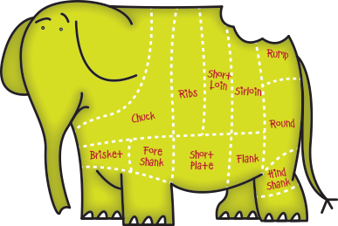
OUR PROJECT
PROMOTING DECENT FUTURE OF WORK APPROACH WITH A FOCUS ON GENDER EQUALITY
One bite at a time

Slide 8
FUTURE OF WORK PROJECT
Designed: by MOLSS
(Dept. of Employment Policies)
Implemented: by consortium led by Weglobal
Financed: by EU & The Republic of Turkey
Refereed: by MoLSS
(Directorate of EU and Financial Assistance)
Managed: by MoLSS
(Dept. of Employment Policies)
Timeline: 01 February 2021 to 31 July 2023

Slide 9
FUTURE OF WORK PROJECT
OBJECTIVE:
To enhance policy-making and implementation capacity of MoLSS
PURPOSE:
To increase the institutional capacity of MoLSS’s Dept. of Employment Policies by improving quality and efficiency of policy-making

Slide 10
PROJECT DESIGN
Capacity
Building
Decent
future of
work
Stakeholder
Cooperation
Communication
Studies

Slide 11
STUDIES
Methodology:
Desk research + stakeholder meetings and workshops + face-to-face + interviews + analysis + reports
Sector Studies – Energy; Health; Education; ICT; Banking/Finance;
People with Disabilities (for decent work future);
Mobbing Complaints;
Impact Assessment (application of current legislation).

Slide 12
STAKEHOLDER COOPERATION AND COORDINATION
Workshops for studies (real data)
International Conference
Workshops for New Employment Strategies (opinion-gathering)
Future of Work Commission (‘blue skies’ thinking)

Slide 13
CAPACITY BUILDING
Conceptual: Decent work for women + Future of work & gender + certificated training by an International organisation
Technical: PCM
Practical: Drafting national strategies & policies + IT-based progress-monitoring system + Advocacy & Awareness-Raising Strategy

Slide 14
COMMUNICATIONS
Introductory film – MoLSS responsibilies for future of work + gender
Spot Film – gender rights
+
Implementation of Advocacy & Awareness-Raising Strategy

Slide 15

THANK YOU!
STAY SAFE!…
AND
WISH US LUCK!

